Slide 1
Software Engineering and Architecture
Concurrency
Shared Resources

Slide 2
Two Threads – One Account
Forelæseren
lønkonto
PBS
deposit
withdraw
OK

Slide 3
Two Threads – One Account
Forelæseren
lønkonto
PBS
deposit
withdraw
Not OK

Slide 4
Example
I insert 200kr while PBS withdraws 100kr. The balance is initially 50kr.
Hopefully, the result should be 50+200-100 = 150 kr.
public boolean deposit(long amount){
if(amount >= 0){
return setBalance(getBalance()+amount);
}
else {
return false;
}
}
public boolean withdraw(long amount){
if(amount >= 0){
return setBalance(getBalance()-amount);
}
else {
return false;
}
}

Slide 5
Concurrent Execution
if(amount >= 0){
return setBalance(getBalance()+200
);
}
else{
return false;
}
Scheduler thread switch!
if(amount >= 0){
return setBalance(getBalance()-100);
}
else{
return false;
}
}
setBalance( 50+200 b=50
setBalance( 50-100 ); b=-50
); b=250;

Slide 6
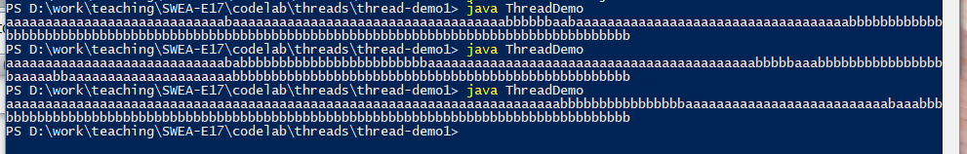
Example
The ‘System.out’ is a shared resource !

Slide 7
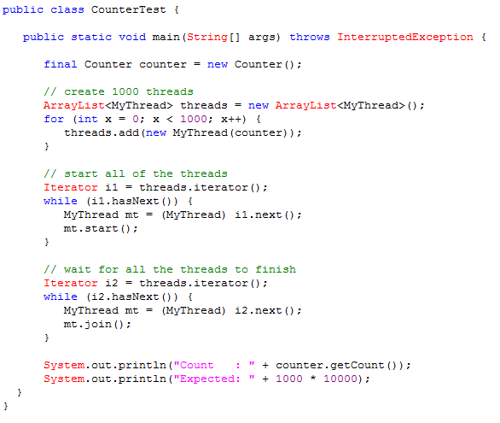
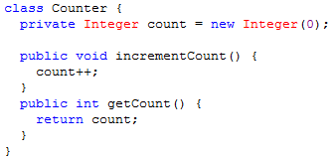
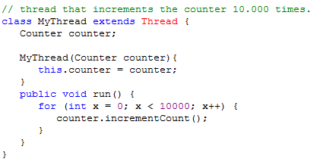
Example: Shared Counter
Source: http://www.javacodex.com/Concurrency/AtomicInteger-Counter

Slide 8
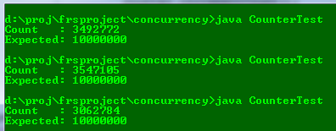
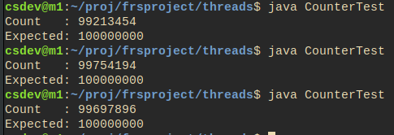
Example: Shared Counter
Source: http://www.javacodex.com/Concurrency/AtomicInteger-Counter

Slide 9

Example: MiniDraw Animation
‘dirtyRectangle’ is a shared resource ☹
Threads move the boxes
MiniDraw’s Jframe does the drawing
The rectangles are shared resources
Notes:
Meta: In Minidraw/demo, only accessible from IntelliJ

Slide 10
Race Condition
Race Condition:
If multiple threads writes to resources then the outcome is determined by the sequence/timing in which events occur.
BAD! You have no control of the behavior of your program; and the result is erroneous
Inserting 200 and withdrawing 100 on balance 50 must be 150
Our particular execution gave 250
The next one may give -50
Critical Section:
The code section in which race conditions can occur

Slide 11
The Solution
Critical sections must be treated as an atomic instruction
Da: ”Udelelig adgang”
That is, only one thread is allowed to be executing in a critical region at a time…
Also called : Mutual exclusion

Slide 12
The Lock
Guard critical regions
Example:
Our two threads will try to invoke deposit() and withdraw()
But our account object, a, has an ”lock” associated
Only one thread may acquire the lock at any time!
Lecturer
a
PBS
The ‘mutex’ or ‘semaphore’

Slide 13
In ‘deposit()’
Lecturer
a
PBS
RUNNING state BLOCKED state
The PBS thread cannot acquire the ‘lock’ and thus start executing ‘withdraw()’. It is simply put into a blocking state, and cannot continue until the lock is released!

Slide 14
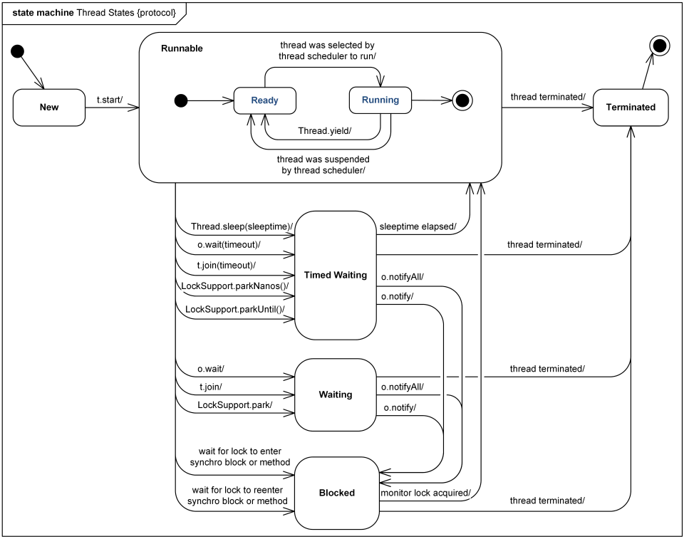
Thread State
Lecturer
PBS

Slide 15
And next…
Lecturer
a
PBS
Thread 1 releases lock…
Lecturer
a
Now thread 2 can ‘withdraw()’
PBS

Slide 16
Monitor/Synchronized
A Monitor is a class whose methods are all associated with a lock/semaphore/”lysregulering”
Not available in Java
In Java it is more fine-grained: synchronized
Only methods with the synchronized keyword will respect the lock
There is only one lock per object !!!
Not one per method!!!

Slide 17

Synchronized
Synchronized methods = whole method is a critical sect.
Do not make too much code a critical section!
It slows a program down if all threads have to wait for the lock
Rule:
Only writing needs to be guarded
Rule 2:
Oh yeah – and reads of items more than N bits
N = 16, 32, 64 - Depending upon your processor !!!
Corollary: Reading objects must be a critical region
Java is portable code?

Slide 18
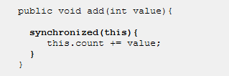
Synchronized Section
You can simply state the object you want to sync on, on a smaller portion of the code!

Slide 19
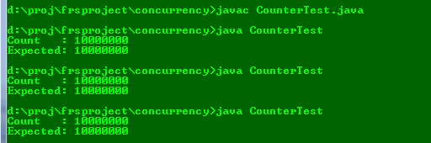
Example again:
Exercise: What should be synchronized?

Slide 20
Server Side and Client Side
So far, the object itself has stated its synchronization.
Often, this is not ok.
Consider this ATM code:
Account.debit() is synchronized
What is the problem???
long available = account.getBalance();
if(available > 0){
System.out.print("You have "+available+
" available, how much do you want? ");
long amount = keyboard.nextLong();
if(amount <= 0){
System.out.println("The amount must be positive.");
}
else if(amount > available){
System.out.println("That is too much.");
}
else{
// This should be ok, but ...
if(!account.debit(amount)){
System.out.println("The ATM debit failed!");
}
}
}

Slide 21
Server Side and Client Side
What is the problem???
long available = account.getBalance();
if(available > 0){
System.out.print("You have "+available+
" available, how much do you want? ");
long amount = keyboard.nextLong();
if(amount <= 0){
System.out.println("The amount must be positive.");
}
else if(amount > available){
System.out.println("That is too much.");
}
else{
// This should be ok, but ...
if(!account.debit(amount)){
System.out.println("The ATM debit failed!");
}
}
}

Slide 22
Client Side Synchronization
Synchronized takes the object as parameter, thus
synchronized(account) {
<<<ATM code here>>>
}
Will solve it – it is executed atomically using the lock of the account…

Slide 23
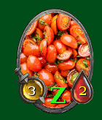
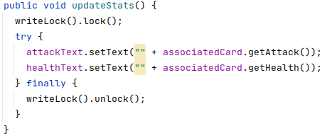
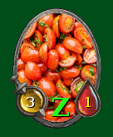
MiniDraw Client Side Sync
MiniDraw, by default, does not lock the ‘Drawing’ during figure manipulation, but offers client-side synchronization via ‘locks’

Slide 24
Reentrance
Hey – did we not miss a thing here???
Thread starts ‘deposit()’
Acquire the lock
Then calls ‘setBalance()’
But the lock is taken???
Reentrant critical sections
If a thread ‘t’ has acquired the lock on object ‘a’, then it is free to invoke all other synchronized methods in ‘a’
Reentrance: The thread may reenter in locked methods
Recursion !
synch
public boolean deposit(long amount){
if(amount >= 0){
return setBalance(getBalance()+amount);
}
else {
return false;
}
}

Slide 25

Example: MiniDraw Animation
Treating ‘dirty rectangles’ as critical region
Single writer
Multi reader

Slide 26
And – moving on…

Slide 27
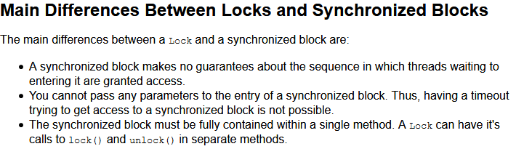
Java 5
Java 5 onwards introduced ‘java.util.concurrent’ because the old ‘synchronized’ was way too simple…
A lot of concurrent data structures
An fine-grained ‘synchronized’ object: Lock

Slide 28
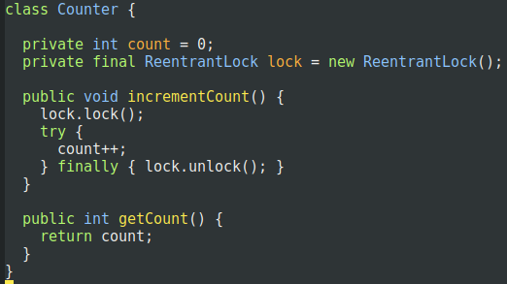
ReentrantLock
Instead of ‘synchronized’ on incrementCount()
Note:
Explicit lock object!
Not on ‘this’…
Can have more locks in play in same object!

Slide 29
The idiom
Or
tryLock(100 ms)
Will time out waiting to get the lock
Avoid indefinite waiting for a lock that a frozen thread has taken!
Liability
Code readability suffers greatly!
Some day you will forget the finally clause ☹
lock.lock();
try {
// critical region
} finally {
lock.unlock();
}

Slide 30
Deadlocks
Availability AntiPattern:
Blocked Threads

Slide 31

Deadlock
Deadlock
A thread waits infinitely for an event that will never happen
That is
T1, is in synchronized method in A, call sync. method in B
T2, has acquired lock on B, and waits for lock on C
…
T4 waits for lock on A – which T1 has !
Result
Utterly nothing!!!

Slide 32
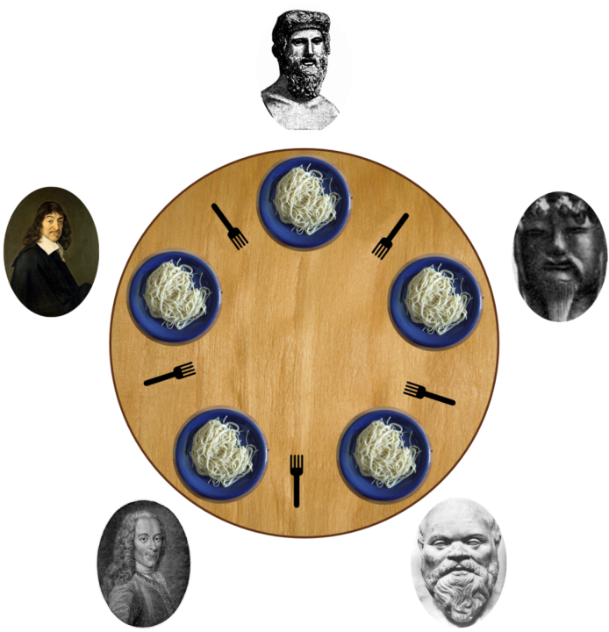
A Classic
Edger Dijkstra, 1965: Dining Philosophers Problem
Eat or think
To eat you need two forks
Design an algorithm that does not deadlock…
[By Benjamin D. Esham / Wikimedia Commons, CC BY-SA 3.0, https://commons.wikimedia.org/w/index.php?curid=56559]

Slide 33
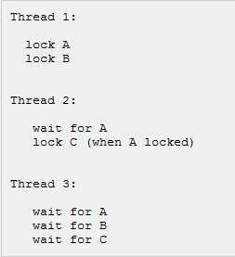
The General Rules of Thumb
Always acquire the locks in the same order
Example: A, then B, then C
Only works if you know the order ahead of time
Use timeouts on locks
If timeout: free all locks, wait, and retry…
Note – does not work for the Philosophers!

